Slide 1
Voltron Therapeutics
Unique drug technology platform focused on broad immune system activation to treat cancer and infectious diseases
Investor Presentation – July 2025

Slide 2
Disclaimer and Safe Harbor
This document does not constitute an offering document. Potential investors or shareholders should not rely on the information contained in this document before making an investment decision. This presentation is being provided for the sole purpose of providing the recipients with background information about Voltron’s business. This presentation, including the information contained in this disclaimer, does not constitute an offer, invitation or recommendation to subscribe for or purchase any security and neither the presentation, disclaimer nor anything contained in them forms the basis of any contract or commitment.
Safe Harbor Statement
This presentation contains "forward-looking statements" within the meaning of the “safe-harbor” provisions of the private securities litigation reform act of 1995. Such statements involve known and unknown risks, uncertainties and other factors that could cause the actual results of the Company to differ materially from the results expressed or implied by such statements, including changes from anticipated levels of revenues, future national or regional economic and competitive conditions, difficulties in developing the Company’s technology platforms, retaining and expanding the Company’s customer base, fluctuations in consumer spending on the Company’s products and other factors. Accordingly, although the Company believes that the expectations reflected in such forward-looking statements are reasonable, there can be no assurance that such expectations will prove to be correct. The Company has no obligation to update the forward-looking information contained in this presentation

Slide 3
Voltron Corporate Overview
Innovative Technology Platform Focused on Providing Novel and Highly Efficacious Treatments for Cancers and Infectious Diseases
Focused on bringing therapeutic and prophylactic immunotherapies to patients with certain cancers or existing/emerging infectious diseases
Platform discovered at Harvard/Massachusetts General Hospital (MGH)/Vaccine & Immunotherapy Center (VIC). Voltron has licensed world-wide rights to the Platform
Research and development collaboration with a world class team of research scientists at Harvard/MGH
Voltron’s Immune Activation Platform – Provides maximum flexibility/ability to attach and deliver a targeted payload to enhance potency toward tumors and infectious pathogens
Initial oncology targets include (VTX-067) Head and Neck, Cervical, (VTX-0P4) Prostate, Bladder, Kidney Cancers
Initial infectious disease targets include current Flu Strains, and Pox Viruses
Pre-Clinical data showed significant improvement in overall survival and tumor reduction and was well tolerated with no adverse events

Slide 4
Voltron Corporate Overview Con’t
Innovative Technology Platform Focused on Providing Novel and Highly Efficacious Treatments for Cancers and Infectious Diseases
Department of Defense (DoD) awarded $5.88 million for pipeline-enhancing work in infectious diseases including recent flu strain, pox-based viruses, and an additional target
Numerous business development opportunities for platform licensing. Focused on platform as monotherapy or in combination with existing products. For example, initial data suggests enhanced efficacy when combined with PD1/Checkpoint Inhibitors such as Keytruda
Voltron’s unique Chemistry, Manufacturing, and Controls (CMC) platform provides improved speed of development and flexibility and reduces costs
The management team includes highly experienced healthcare industry executives
Strong intellectual property position. Opportunities to rapidly expand and broaden the IP portfolio

Slide 5
Voltron Team – An Outstanding Track Record Highly experienced Voltron team driving this initiative has collectively filed more than 70 INDs, executed 130+ clinical trials, authored more than 500 scientific papers, and contributed to 15 product approvals and 16 product launches
ORGANIZATION | KEY LEADERSHIP AND ADVISORS | EXPERIENCE
Voltron Therapeutics Executive Management Team | Anthony Zook ; Advisor | Fmr. CEO, AstraZeneca NA
Voltron Therapeutics | Pat Gallagher; CEO, Director | Management & Finance
 | Matthew Duffy; President, Director | MedImmune, Lev Pharmaceuticals
 | Paul Korner, MD; Director – Clinical Development | Sarepta, Axovant, Ferring, Bayer, Wyeth
 | Simon Pedder, PhD, Director | Fmr. VP Oncology, Roche
 | Ishan Capila, PhD – CMC | Momenta Pharmaceuticals
 | George Steinfels, PhD –Clinical Operations/Regulatory | Quintiles (IQVIA), DuPont Merck
Vaccine & Immunotherapy Center (VIC) at Mass General Hospital (MGH) and Harvard | Mark Poznansky, MD, PhD; Director, VIC | Infectious disease immunology, translational research
 | Michael Callahan, MD, DTM&H (UK), MSPH; Director, Translational Research, VIC | Emerging infectious diseases, biological product development
 | Jeff Gelfand, MD; Senior Scientist, VIC | Infectious diseases, SAV technology inventor
 | Patrick Reeves, PhD – Investigator, Instructor | Principal Investigator at VIC, Instructor at MGH, and Instructor of Harvard Medical School. Research focus on immune modulating therapies and vaccine development

Slide 6
Shareholder Value Creation
Additional R&D milestones will create significant value for liquidity event/public offering and for strategic partners

Slide 7
2025 – Key Objectives and Milestones
The key objectives in 2025 are designed to drive strategic relationships with biopharma companies (upfront $, royalties, etc.) and create additional value ahead of our anticipated public offering
2Q – Completed VTX-0P4 with anti-PD1 (Prostate, Bladder, and Renal Cancers) Pre-clinical study
Prostate-Stem-Cell-Antigen (PSCA) trial demonstrated statistically significant improvement in survival and tumor reduction
VTX-0P4 was well tolerated with a favorable safety profile
Positive results confirm significant value in the platform’s flexibility
3Q – Initiate VTX-067 (Head and Neck and Cervical Cancers) Pre-clinical toxicology study
Critical step to move toward human clinical trials.
Data is also a ‘must have’ for strategic partnering discussions.
Toxicology results to date have produced a very clean safety profile
3Q/4Q – Explore strategic partnering/licensing opportunities
The PSCA and Toxicology data will add a great deal of value to these efforts
To date, we will have used 3 VERY different warheads to attack three very different disease target
Pursue additional government funds across the platform

Slide 8
2025 – Additional Potential and Significant Value Creating Events and Programs
Combination of Voltron’s platform with a large class of immunotherapy compounds with a different mechanism of action than Checkpoint Inhibitors. Promising pre-clinical results were observed with overall improvement of efficacy.
The enhancement of market-leading therapies with different and distinct capabilities is a powerful demonstration of the platform’s efficacy and flexibility
Exploring additional forms of delivery to expand market potential
Successfully conducted extensive preclinical research and development work using microneedle/patch delivery of cancer therapy
Pipeline expansion
Building on our multiple successes in various cancers, we have initiated additional multi-tumor associated protein targeting (Ovarian and Mesothelioma)

Slide 9
The Science Behind the Platform
The technology elicits and enhances a powerful immune response that can significantly improve efficacy and duration of effect

Slide 10
Proprietary Platform Has Two Components: Fixed & Variable
Fixed Component
IMMUNE CELL ACTIVATING
MtbHSP70
AVIDIN
Variable Component
PATHOGEN TARGETING PAYLOAD
BIOTIN
PEPTIDES, PROTEINS, ETC.
Notes:
Split up the

Slide 11
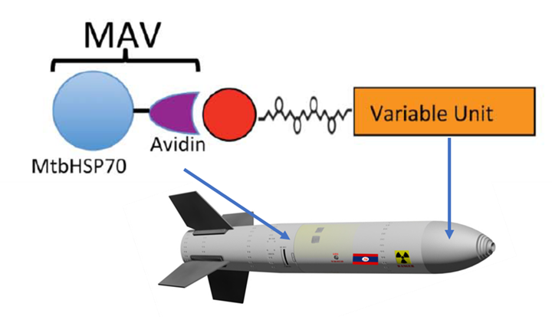
Voltron’s Technology Utilizes Key Component MtbHSP-70
Rapid development of therapeutics consisting of two components:
Fixed fusion protein of M. Tuberculosis Heat Shock Protein-70 (MtbHSP-70) combined with Avidin to form the MAV
Fixed component can be manufactured, stockpiled in advance and used in all Voltron therapies
Statistically significant enhancement of immune targeting and survival vs. standard delivery vehicles
Variable/specific biotinylated immunogenic epitopes identified by in-silico screening method to target. This includes peptides, proteins, polysaccharides, small molecule, lipids, Mabs, etc.
Oncology
Infectious Diseases
Fixed Component (MAV)
Targeting Payload/ Variable Component
Variable Unit
Avidin Biotin
Biotin
MtbHSP-70
MAV combined with the payload creates a powerful, targeted immune response

Slide 12
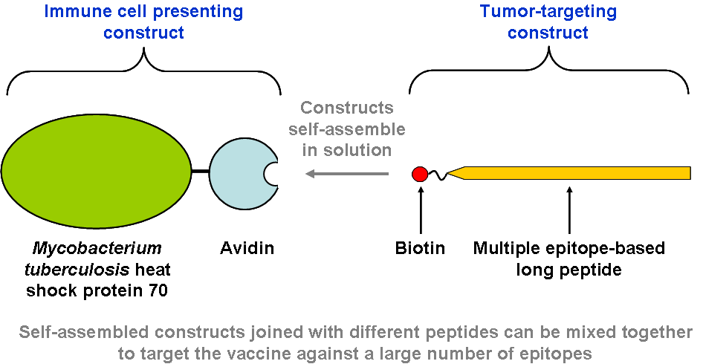
Immune Activating VTX-OP4 & VTX-067 Components
Fixed Component
Immune Cell Activating
Variable Component
Cancer Targeting Payload
MAV
Tumor-targeting Antigen
PSCA, HPV E6/E7, etc.

Slide 13
MtbHSP-70 Unique Adjuvant Drives Robust Immune Engagement & Response to Tumors and Pathogens
MtbHSP-70 is the novel adjuvant that is integral in the fixed component of the therapy
MtbHSP-70 provides maximum flexibility/ability to attach and deliver a targeted payload to enhance potency toward tumors and infectious pathogens. (This is the variable component of the therapy)
MtbHSP-70 acts as a “Swiss army knife” of the body’s defense engaging multiple parts of the immune system against a wide range of foreign substances including:
Engages dendritic cells
Increases Tumor Necrosis Factor (TNF), driving tumor cell death
Immune response is well-balanced with CD8+ (Killing) and CD4+ (Targeting/Memory) T cells
MtbHSP-70 has the potential to improve currently available drugs and extend patent protection

Slide 14
Platform Study Data: Voltron’s Immune Activation Technology Platform Generated Robust Immune Response and Significantly Increased Survival vs Gold Standard Alum
The study examined the immunogenicity and efficacy of Voltron’s fixed component, mtbHSP-70 vs. a gold standard fixed component/adjuvant, Alum, with the same payload attached
An adjuvant is used in a vaccine and is designed to promote and enhance an immune response to an antigen
There was no significant immune response in mice vaccinated with standard adjuvant (Alum)/E6
The mtbHSP-70 immune response is well-balanced between CD8+ (Killing) and CD4+ (Targeting/Memory) T cells
The survival of tumor bearing mice was significantly prolonged with MtbHSP-70/E6, but no significant difference noted among adjuvant/E6 or saline treated groups
Efficacy of a new, higher dose established 80µg

Slide 15
Voltron’s Immune Activation Platform Delivers Superior Efficacy Versus Alum, a Gold Standard Adjuvant MtbHSP-70 Data Showed Significant Advantages in Tumor Response and Survival in Very Aggressive Tumor Model
TC-1 cell injection
VTX-067
injection
VTX-067
injection
VTX-067
injection
VTX-067- High % of mice alive at end of trial
Alum/Gold Standard – Low % of animals alive at end of trial
Day 0
Day 3
Day 17
Day 31
HPV E6 SAV (Mice)
Tumor volume (mm³)
3 0 0 0
Probability of Survival
Saline
2 5 0 0
1 0 0
Alum (5%)-E6(35μg) ^{0.0041}
0.3311
2 0 0 0
7 5
SAV (80 μg)
0.0544
1 5 0 0
5 0
1 0 0 0
5 0 0
2 5
0
0
1 0
2 0
3 0
4 0
0
Day
0
1 0
2 0
3 0
4 0
5 0
Day

Slide 16
Voltron Therapeutics Pipeline
Product | Indication | Discovery | Pre-Clinical- IND | Phase 1 | Phase 2 | Phase 3
VTX-067 | Oncology Head and Neck, Cervical
VTX-0P4 | Oncology Prostate, Bladder, Renal
VTX-ID24 | Infectious Disease Influenza vaccination Government funded
VTX-ID57 | Infectious Disease Pox – Vaccinia Government funded

Slide 17
Voltron Received $5.88M Award from the Department of Defense (DoD) in June 2023
Significant Non-Dilutive Capital Value Creation
Rigorous External Validation of Platform Technology
This award will fund the further development of the platform for the rapid production of prophylactic therapies for select infectious diseases
Voltron’s platform is designed for use in the United States Military and in the general population
In addition to Immuno-Oncology programs, accelerates and expands Voltron's development pipeline to include three infectious disease candidates to be developed in collaboration with the DOD
This award acknowledges the potential importance of the platform’s novel mode of action, which could significantly increase the speed and reduce the cost of therapy development for a wide range of pathogens

Slide 18
Voltron Technology Platform: Immuno-Oncology Pipeline
Pre-clinical data demonstrates a dramatic improvement in overall survival and tumor regression/eradication. Significant opportunities in combination with multiple therapies, including checkpoint inhibitors (PD-1s)

Slide 19
Voltron Oncology Pipeline Overview
Innovative Technology Platform Focused on Providing Novel Treatment Solutions in Difficult to Treat Cancers
VTX-067 (Head and Neck/Cervical) Potent activity in E6/E7 Human Papilloma Virus (HPV) related cancer animal models
IND pathway and First-In-Human protocols confirmed through FDA Pre-IND meeting
E6/E7 expressed in 100% of Cervical, Head and Neck cancers
VTX-0P4 (Prostate, Bladder, and Renal) Prostate-Stem-Cell-Antigen (PSCA) therapy candidate demonstrated statistically significant dose-dependent immune system activity against its tumor target, PSCA, in pre-clinical animal models
Preclinical studies for VTX-0P4 with anti-PD1 – Showed statistically significant improvement in survival and tumor reduction
PSCA expressed in 80% - 90% of primary Prostate Cancers, 95% of Renal Cancers, and 50% of Bladder Cancers
Potential Future Oncology Targets:
Nectin-4 – attractive tumor-associated antigen target in Lung, Ovarian, Esophageal, and Bladder

Slide 20
Market Opportunity Overview
Our targets address unmet medical needs with large commercial opportunities
These are very high-value targets with abbreviated regulatory pathways
Initial focus will be on Orphan Drug cancers as classified by the FDA
 | Current Targets |  |  |  |  |  | Future Targets
 | Cervical | Anal | Head & Neck | Bladder | Renal | Prostate | Mesothelioma | Ovarian | Esophageal
Estimated Annual New Cases | 14,480 | 9,090 | 54,010 | 83,730 | 76,080 | 248,530 | 3,000 | 21,410 | 19,260
Estimated Annual Deaths | 4,290 | 1,430 | 10,850 | 17,200 | 13,780 | 34,130 | 2,500 | 13,770 | 15,530

Slide 21
Voltron’s Platform Potentially Improves Current Treatment Efficacy and Cancer Patient Outcomes
Voltron’s therapy is designed to increase response rates, durability of response, and reduce toxicity
Limitations of Current Therapies:
Have low response rates (RR) in recurrent tumors (including Checkpoint Inhibitors/PD-1’s). There is still a high unmet medical need, with only a small percentage (14-22%) of patients who respond to treatments with PD-1’s
PD-1’s have high off-target effects leading to significant adverse events and side effects
Benefits of Voltron’s Novel Platform:
Directs primed/stimulated T cells to established tumor targets
Trains T cells to target over-expressed proteins found in specific tumor types
Significant opportunities for the platform to be used in combination with existing therapies, including Checkpoint Inhibitors/PD-1’s

Slide 22
Proof-of-Concept (POC) VTX-067 HPV E6/E7 Demonstrated Significant Improvement in Survival as Monotherapy and in Combination with PD-1 in Tumor Mouse Model Study
Overall survival and suppression of tumor growth were most impressive in the 215μg VTX-067 group
+/- ∝PD1, no mice treated with 215μg VTX-067 met euthanasia criteria until all Saline/Peptide/MAV-treated mice expired
Single Agent
Combination
Saline +∝IgG
****p ≤ 0.0001
0
10
20
30
40
50
0
10
20
30
40
50
Days
Days
Animals NOT treated with the three highest doses all expired by day 32
INCREASED SURVIVAL: VTX-067 showed a significant survival benefit with a high percentage of animals remaining alive at the conclusion of the study

Slide 23
POC VTX-067 HPV E6/E7 Demonstrated Significant Reduction in Tumor Growth as a Monotherapy and in Combination with a PD-1 in Mouse Model Study
Single Agent
Combination
4000
Saline +∝IgG
Peptide +∝IgG
MAV 80μg +∝IgG
SAV 20μg +∝IgG
SAV 80μg +∝IgG
SAV 130μg +∝IgG
SAV 215μg +∝IgG
4000
****
Saline +∝IgG
Saline +∝PD1
Peptide +∝PD1
MAV 80μg +∝PD1
SAV 20μg +∝PD1
SAV 80μg +∝PD1
SAV 130μg +∝PD1
SAV 215μg +∝PD1
3500
****
3500
****
****
****
****
****
****
3000
3000
****
****
2500
2500
****
****
****
Tumor Volume (mean, mm³)
****
Tumor Volume (mean, mm³)
2000
****
2000
****
****
1500
1500
****
1000
1000
*
**
500
500
*
*
0
0
*p ≤ 0.05
**p ≤ 0.01
***p ≤ 0.001
****p ≤ 0.0001
0
10
20
30
40
50
0
10
20
30
40
50
Days
Days
Tumors in control groups grew aggressively, with all control mice meeting euthanasia criteria by day 31 (i.e., Saline, Peptide, MAV)

Slide 24
POC: Clear, Positive Efficacy Results Meaningful Tumor Free Survival in Highly Aggressive Tumor Model as a Monotherapy and in Combination with a PD-1
Number of Mice Tumor Free After VTX-067 Treatment
Single Agent
PD-1 Combination
Several mice in each of the 80, 130, and 215μg groups survived without measurable tumors, while no mice in any other groups remained tumor-free
215μg VTX-067 + ∝PD1, 4/10 mice tumor-free at end of study (day 42)

Slide 25
POC VTX-067 HPV E6/E7 Tumor Mouse Model Study Summary of Positive Results
Achieved Significant Overall Survival and Tumor Reduction
The Primary Endpoints of The Study Were Met
Overall Survival: VTX-067 had a significantly improved survival effect at 80, 130, and 215μg VTX-067 doses in the TC-1 tumor-injected mice
Tumor Volume Reduction: VTX-067 significantly reduced TC-1 tumor volume with reduced tumor volume in the 80, 130 and 215μg dosing cohorts
Dose-Response: There was a clear dose-response to VTX-067 with the best tumor volume reduction and survival benefit in the TC-1 tumor-bearing mice at 215μg
The Secondary Endpoints of The Study Were Met
Reactogenicity: VTX-067 is well tolerated with a favorable safety profile. There was no reactogenicity and observed no serious adverse events

Slide 26
VTX-067 Pre-IND FDA Meeting: FDA Response=Platform Validation (Value of Our CMC/Peptide Selection, Etc.)
FDA Pre-IND Responses Significantly Reduces Platform Risk and Increases Visibility to First-in-Human Studies
Science Requirements: Safety & Efficacy | Efficacy Outstanding results/survival in E6/E7 Excellent safety in E6/E7 studies
Operating Requirements: CMC is the Most Important Issue | FDA provided valuable feedback supporting Voltron’s development path for E6/E7 program Our development approach and protocols were confirmed by the FDA’s recommendations
Conclusion: | This feedback on Voltron’s CMC with the FDA is critical and extremely valuable Affords use with any new targets in Immuno-Oncology and Infectious Diseases Allows the company to accurately generate timelines, budgets, vendor requirements, etc.

Slide 27
Voltron Summary Highlights
Dedicated to Developing Innovative Treatments for Cancer and Infectious Diseases
Proposed liquidity event/public offering and significant R&D milestones in 2025
Proprietary technology platform developed and licensed from MGH and Harvard, with world-class research scientists participating in clinical trials
Platform provides multiple opportunities for cancer and infectious diseases
VTX-067 for HPV related cancer (lead indication), Head and Neck, Cervical, and Anal Cancers
VTX-0P4 for Prostate, Bladder and Renal Cancers
Extremely strong pre-clinical data provides confidence for potential multiple combination drugs
Pre-clinical data shows significant efficacy with a favorable tolerability and safety profile
Received a $5.88M award from the DoD for treatments for cancer and infectious development in June 2023
Product development driven by a strong management team of highly-experienced healthcare industry executives

Slide 28
Contact
Pat Gallagher
Chief Executive Officer
+1 973-216-6014
pgallagher@luciuspartnersllc.com

